Slide 1
Amazon Web Services : The best career choice for cloud aspirants
View Cloud Computing Course details at www.edureka.co/cloudcomputing
For Queries:
Post on Twitter @edurekaIN: #askEdureka
Post on Facebook /edurekaIN
For more details please contact us:
US : 1800 275 9730 (toll free)
INDIA : +91 88808 62004
Email Us : sales@edureka.co
Notes:
<number>

Slide 2

Agenda of the Webinar
What is Cloud Computing
What is AWS? Advantage of AWS?
Demand for Cloud?
Types of Certifications in AWS
Types of Cloud Professionals
Future Trends in Cloud Computing
Courtesy: Slideteam

Slide 3
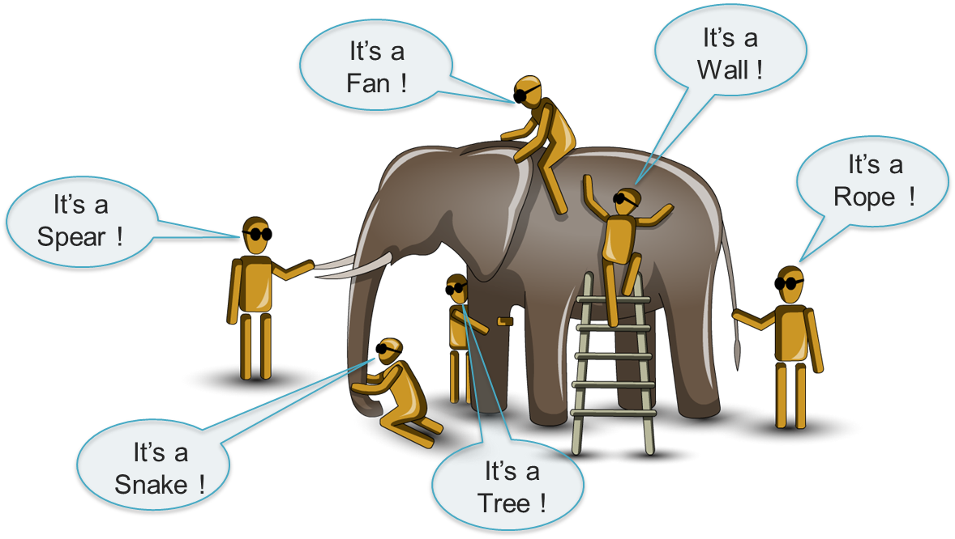
What is Cloud Computing?

Slide 4
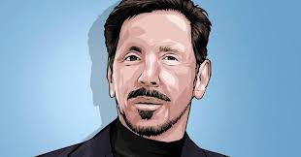
Generally Speaking…
Cloud = Internet?
Cloud Across Devices
Types of Cloud
Advantage of Cloud
SaaS
PaaS
Courtesy : CNBC
IaaS
They don’t call it the Internet Anymore, They call it Cloud Computing. I’m no longer resisting the name. Call it what you want – Larry Elison (Oracle)

Slide 5
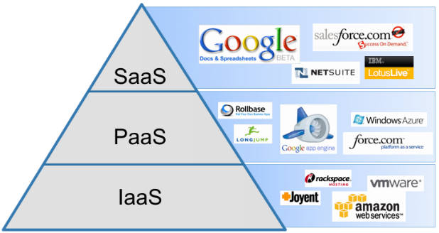
Types of Cloud
Courtesy :Virtualclouds.in

Slide 6

What is AWS?
What is AWS?
Overview of AWS Products
Compute, Storage, Database, App Services, Deployment and Management, Networking
AWS Free Tier
1 Year free tier with all services
Basic Key Words
AMI, Instance, Volume, Snapshot

Slide 7

Why Organizations choose AWS?

Slide 8
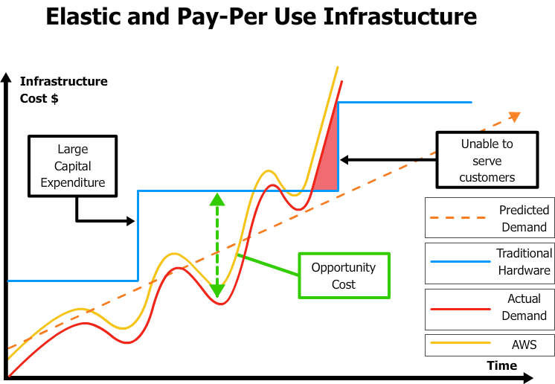
Advantage of AWS
Available Anywhere
On-Demand Provisioning
Scalable
Pay per usage
Resource Pooling

Slide 9
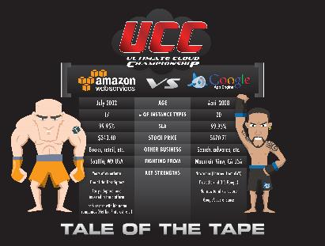
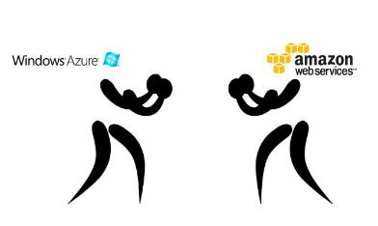
AWS vs Azure vs Google
Courtesy : Stackify/Sciencelogic

Slide 10

Demand for Cloud

Slide 11
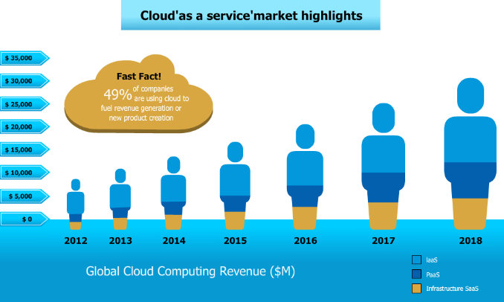

“Every kid coming out of Harvard, every kid coming out of school now thinks he can be the next Mark Zuckerberg, and with these new technologies like cloud computing, he actually has a shot.”
- Marc Andreessen, Board Member of Facebook
http://community.trapponline.com/10-must-read-quotes-about-cloud-computing/

Slide 12



Fast Facts
As per Forbes Report there are 3.9 Million jobs affiliated to cloud computing with 384,478 in IT alone
Why take Cloud for a Career?
Median salary for IT Professionals with Cloud Computing knowledge between $100k - $117 k annually!
As per Infoworld, Being a Cloud Architect is one of the 6 Hottest Jobs globally apart from Data Scientists & Business Architect

Slide 13
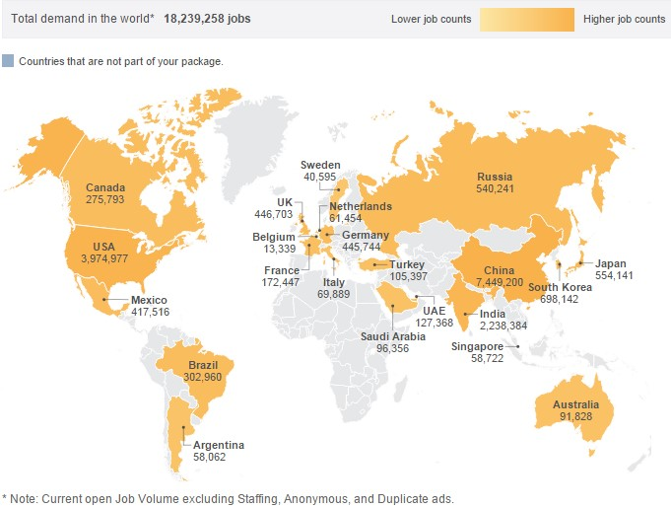
Global Demand – Study by Wanted Analytics

Slide 14

?
System Ops
AWS
?
Cloud Developer
Cloud Admin
?
AWS
Where do you go from here?

Slide 15
Types of Certifications
Cloud Developer Certification
Amazon Web Services
Cloud Administrator Certification
System & Operations Certification

Slide 16

Who is a SysOps Administrator?
+1 Year Experience in System Administration
Well Versed in Windows & Linux System Administration
Certification to go for – ‘AWS Certified SysOps Administrator –Associate’
Develop, Manage, operating scalable, highly fault tolerant, systems in AWS
Controls flow of data through AWS, Implements AWS , focus on operations
Courtesy : RVsitebuilder

Slide 17

Who is a Cloud Developer?
Top in the Stack among all Cloud Computing Jobs.
+10-15 Years Experience
Knows administration, integration & coding.
Certification to go for – ‘AWS Certified Developer –Associate’
Picks the Right AWS Service for Application, Codes for Performance optimizations, handles code level application security.
Courtesy : Insidejobs

Slide 18

Who is a Cloud Architect?
+2 or more year hands-on experience designing & deploying in cloud architecture on AWS.
Design & Deploy dynamically applications in AWS
Certification to go for – ‘AWS Certified Solutions Architect –Associate/Professional’
Migrating Multi-tier applications & implementing cost control strategies.
Courtesy : Focusit

Slide 19

Future Trends in Cloud Computing

Slide 20



Hybrid Cloud as Primary Cloud Strategy
Cost Reduction – The Race to Zero
More Adoption of Cloud Services
Source : Techradar, Ingram

